Slide 1


Slide 2

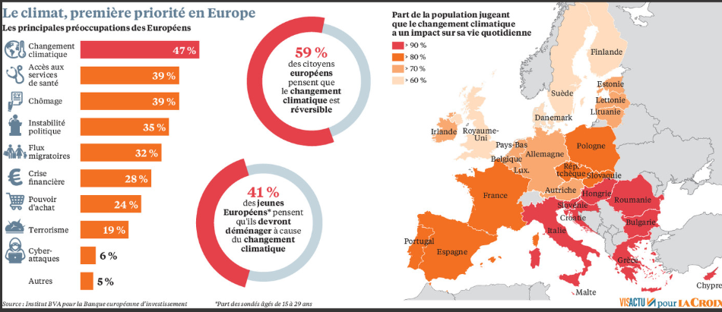

CONTEXT
According to a study by the European Investment Bank (November 2019) and Opinion Way,Climate change is the number one challenge for 47% of Europeans and especially 58% of 18-30 year olds. This concern comes ahead of access to the health care and healthcare system (39%) and unemployment (39%).European citizens therefore expect political responses to tackle the environmental threat.

Slide 3
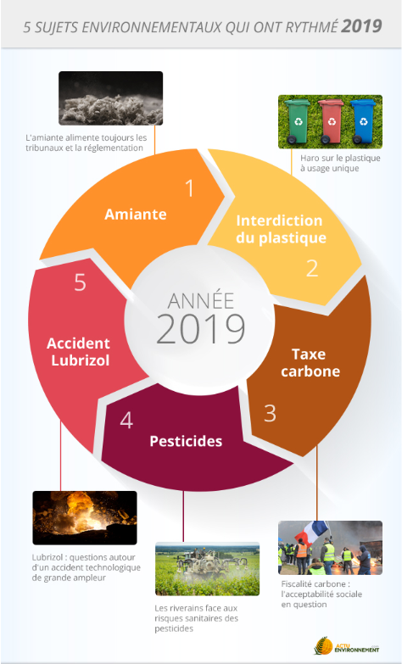
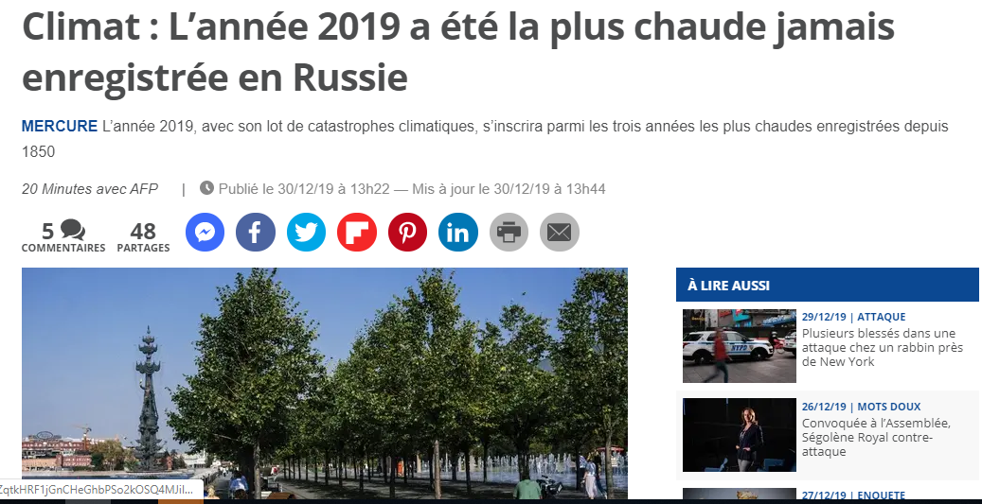
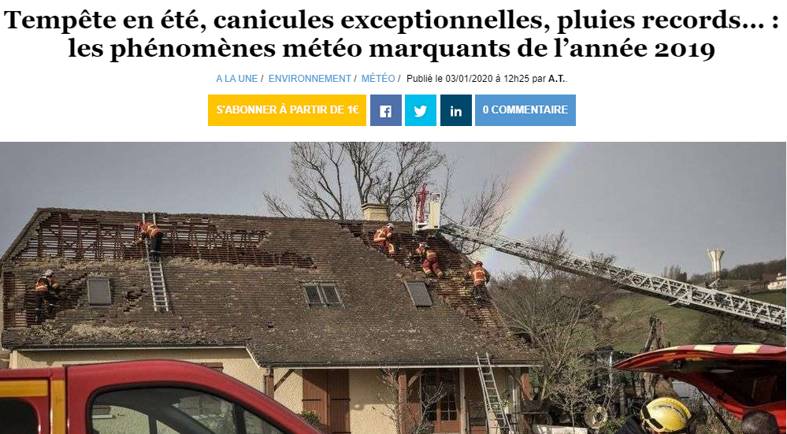
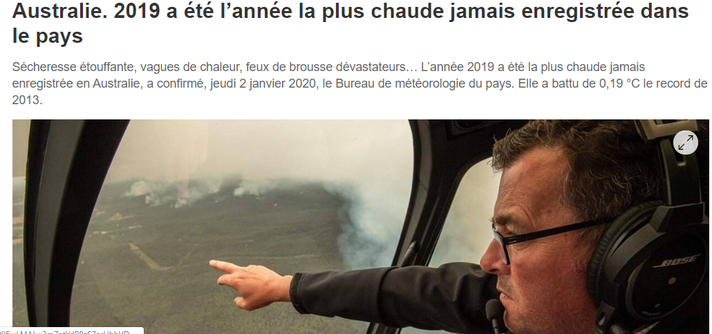
CONTEXT
In France, the 5 environmental topics that have
set the pace for 2019.
And all over the world

Slide 4
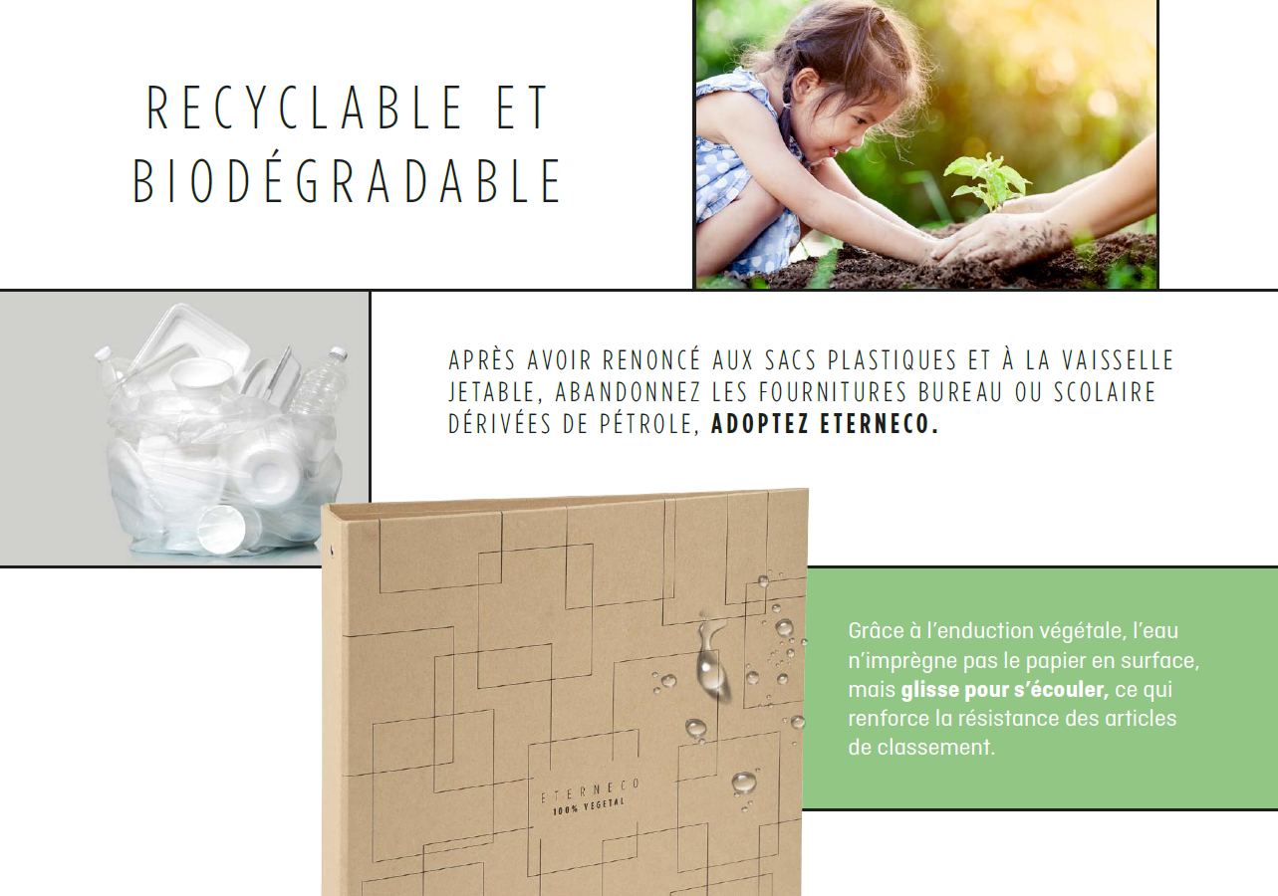
  THE FIRST
  ACTIONS
The first measures have already been put in place:
The end of single-use plastic (2020 in France, 2021 in Europe).
The increase in recycling of plastic waste throughout Europe.
This is only the beginning!

Slide 5
THE LIKELY EVOLUTION
From the elimination of single-use plastics, we are moving towards the elimination of plastic when it can be substituted either by :
Vegetable components (paper, cardboard, starch...)
Recycled and recyclable components (tetra pack, recycled plastic).
As the supply market is easy to reform (no lobbying, few mass actions...), it is likely to be one of the first to be impacted.
Already some distributors (Metro) are thinking about "plastic-free" assortments.

Slide 6
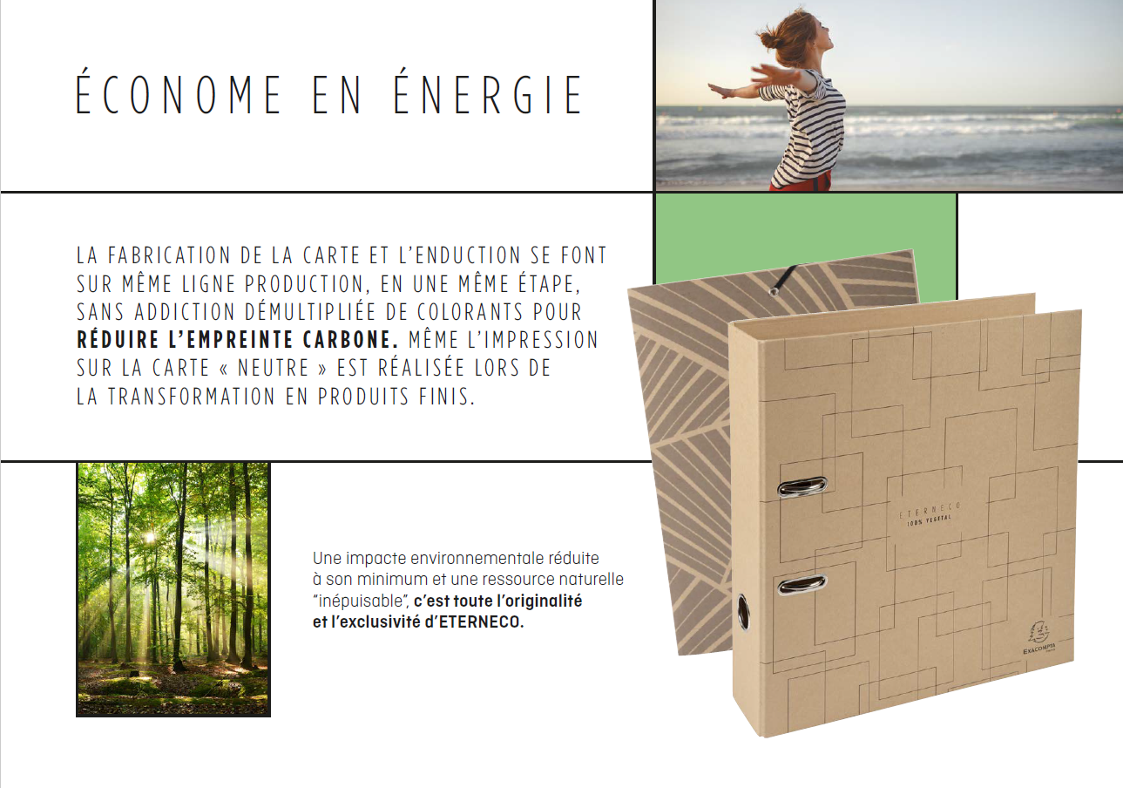
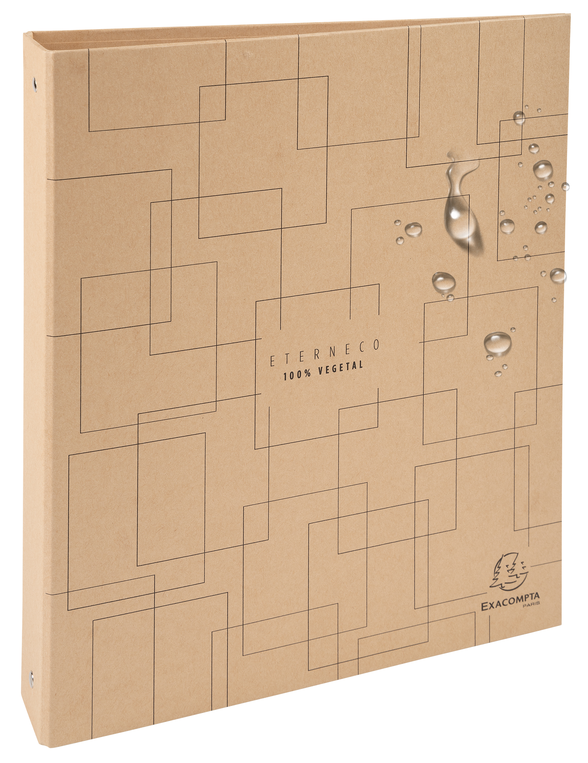

  OUR ANSWER
A paper range that replaces plastic.
Composed of wood residues and protected by a vegetable oil, the card is water resistant while being recyclable and degradable in nature.
A true innovation from Exacompta-Clairefontaine!

Slide 7
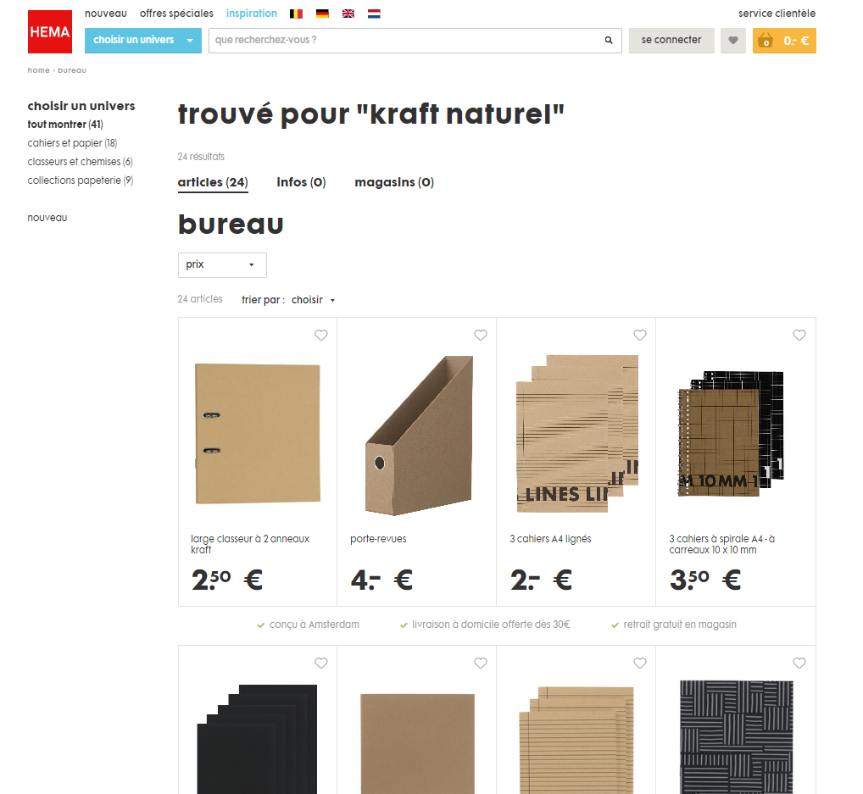
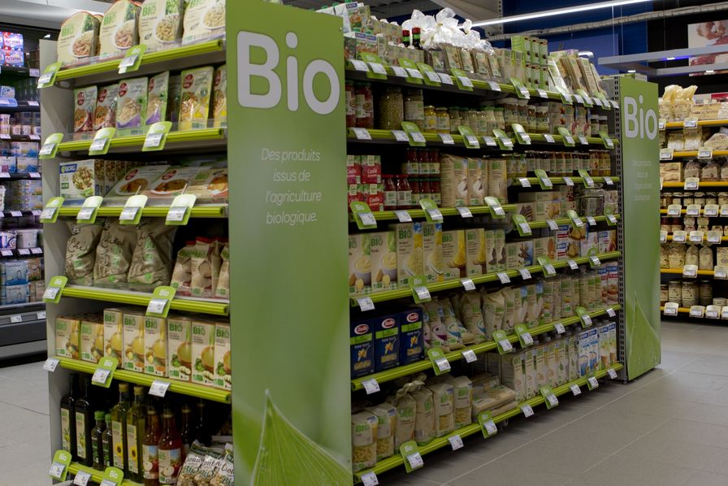
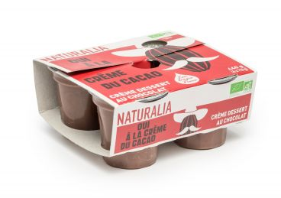
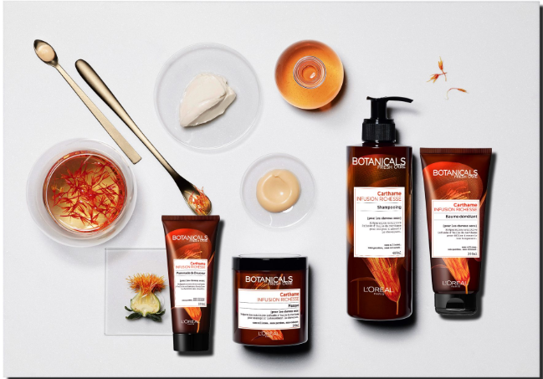
  COMMITTED AND NATURAL
In addition to this commitment to replace the plastic in our everyday products, Eterneco has a natural look that is popular with consumers (480 million instagram publications on #nature, 841K on #kraft!).The products are uncluttered, without the addition of back labels, communication, EAN, packaging, film... to focus on the essentials.
Committed and trendy!

Slide 8
EARLY FEEDBACK FROM CUSTOMERS
The range was unveiled from September at a handful of distributors.
The results are as follows:
Selected at TEDI, a chain in Germany.
Selected by Monoprix for the 2020 Back to School season.
Positive reception from Cultura, waiting for selection.
It's up to you!

Slide 9

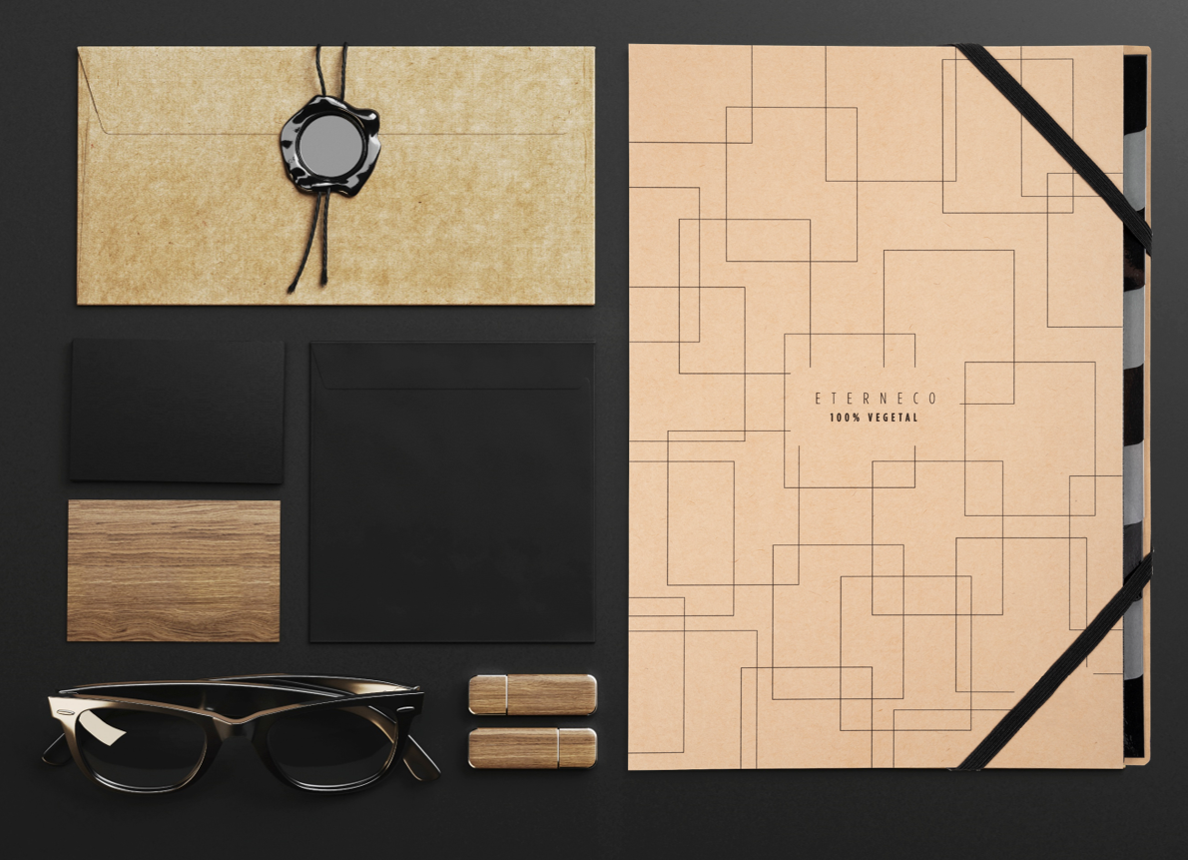
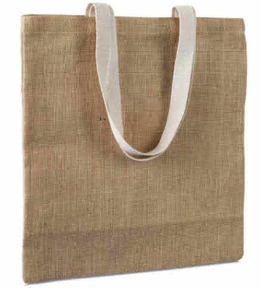


TO HELP YOU
A stop-shelf POS kit and poster that explains the range in store
Ref : 99147E
For any order of 300€ minimum, delivered from March 2 to April 30, 2020 (delivery dates), the customer benefits from : A box of 20 burlap bags, 30x 40 cm, with free Exacompta logo=> To be added in the order: Ref 14007E

Slide 10



